Slide 1
Symmetric Key Algorithms
DES, IDEA, RC5, Blowfish, AES
S-DES, DES, Triple DES

Slide 2
Prerequisites
Algorithm Types – An Algorithm type defines what size of plain text should be encrypted in each step of the algorithm.
Algorithm Modes – The algorithm mode defines the details of the cryptographic algorithm, once the type is decided.

Slide 3
Algorithm Types
Stream Ciphers – It involves encryption / decryption of one plain text / cipher text bit at a time.
Block Ciphers – It involves encryption / decryption of one plain text / cipher text block at a time.

Slide 4
Stream Ciphers - An Example
In text format
In binary format
Pay 100
010111001
In binary format
XOR operation
100101011
Key
ZTU91^%D
110010010
Cipher text

Slide 5
Block Ciphers - An Example
FOUR
_AND_
FOUR
Plain text
Encrypt
Encrypt
Encrypt
VFA%
*yT1x
VFA%
Cipher text

Slide 6
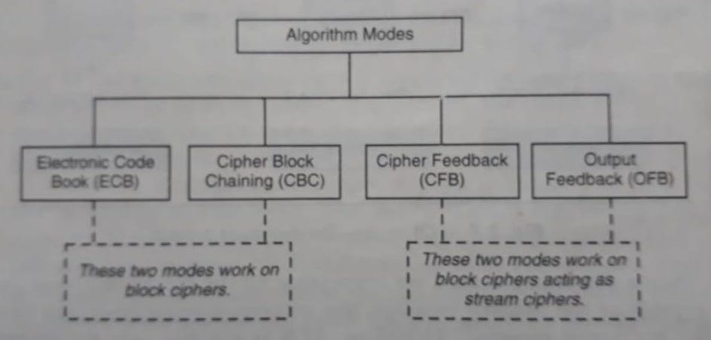
Algorithm Modes

Slide 7
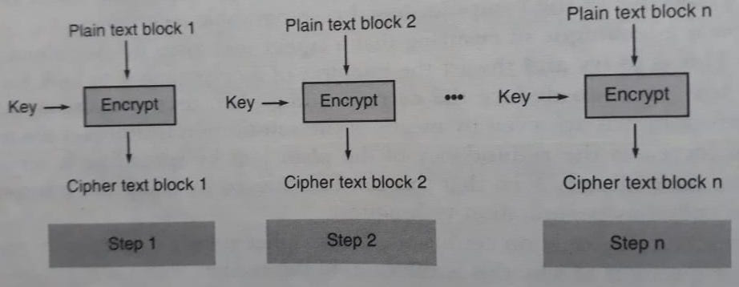
Electronic Code Book(ECB) Mode --- Encryption ---

Slide 8
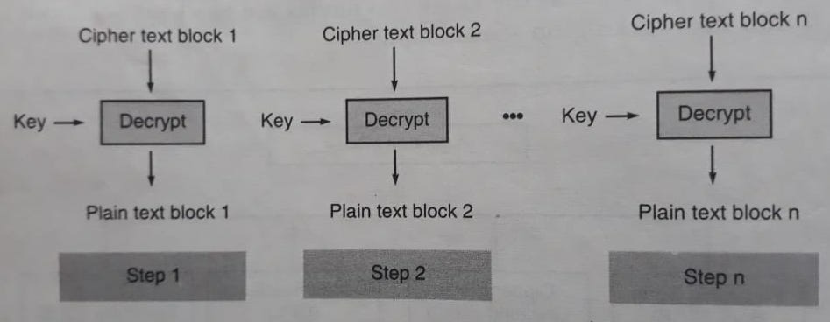
Electronic Code Book(ECB) Mode --- Decryption ---

Slide 9
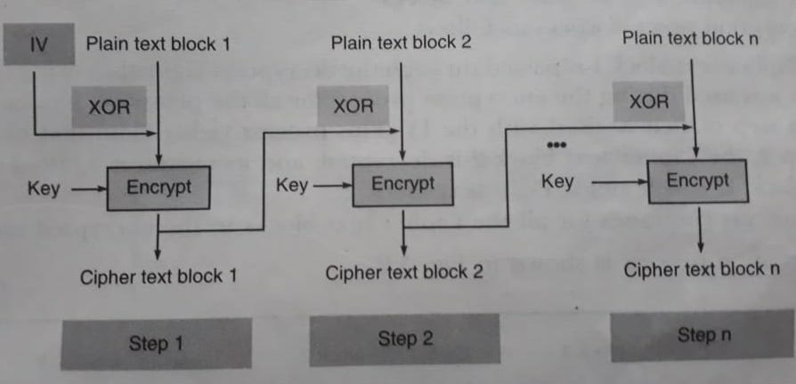
Cipher Block Chaining(CBC) Mode --- Encryption ---

Slide 10
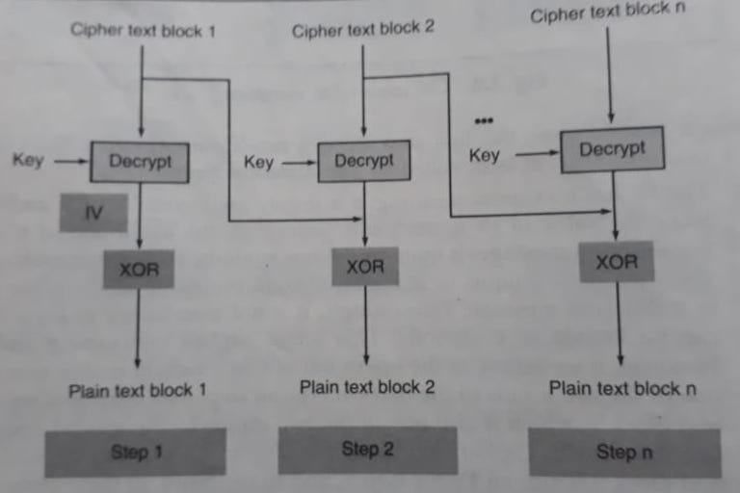
Cipher Block Chaining(CBC) Mode --- Decryption ---

Slide 11
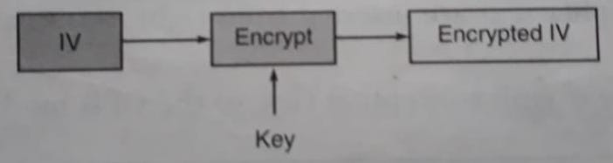
Cipher Feedback (CFB) Mode --- Step 1 ---

Slide 12
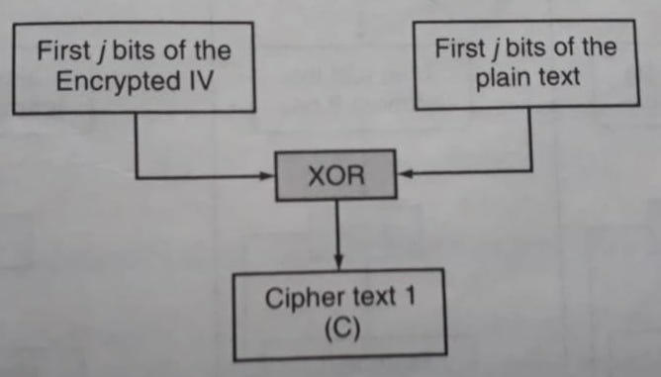
Cipher Feedback (CFB) Mode --- Step 2 ---

Slide 13
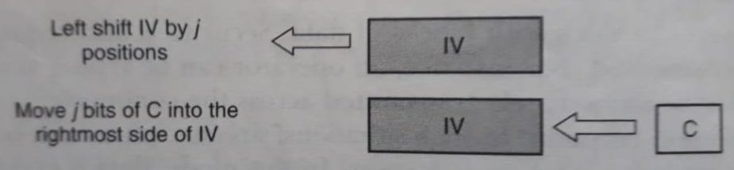
Cipher Feedback (CFB) Mode --- Step 3 ---

Slide 14
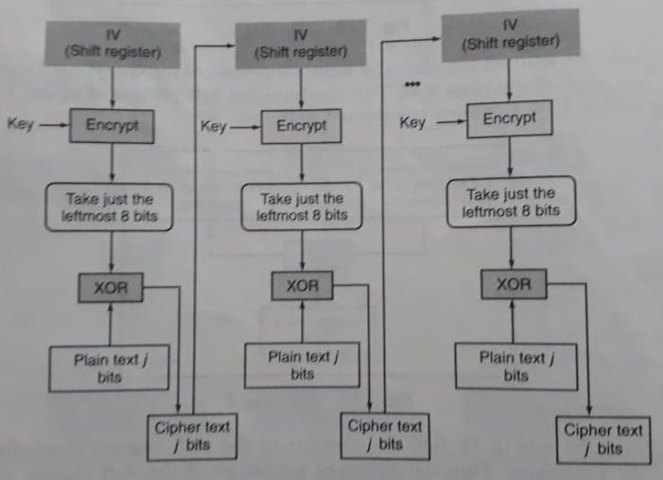
Cipher Feedback (CFB) Mode --- The Overall Encryption Process ---

Slide 15
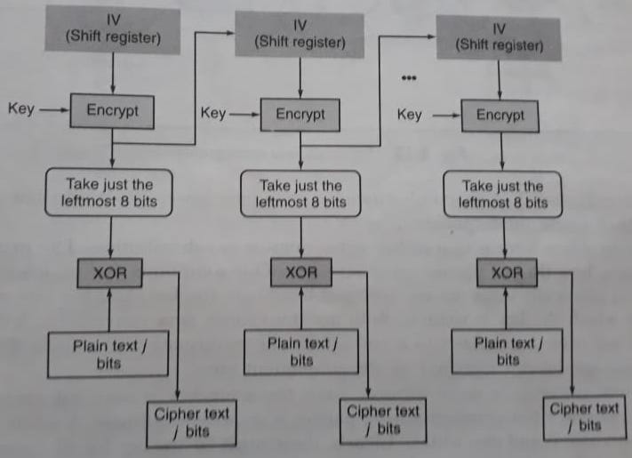
Output Feedback (OFB) Mode --- The Overall Encryption Process ---

Slide 16
Next Topic
Simplified Data Encryption Standard
(S-DES)

Slide 17
Thank you
Notes:
Is your presentation as crisp as possible? Consider moving extra content to the appendix.
Use appendix slides to store content that you might want to refer to during the Question slide or that may be useful for attendees to investigate deeper in the future.

